Slide 1

February 2022
@chartgerink
chris@libscie.org
Notes:
Hi everyone
Today I’ll be giving a demo of ResearchEquals.com, a new open access publishing platform, built with researchers.
Everything I show you today, you can start using right now.

Slide 2

Notes:
The idea behind the platform is that research goes through a lot of steps and winding paths, which usually end up in a research paper.
But those papers, don’t show those paths.

Slide 3
Notes:
So we’re left wondering, whenever a paper gets published, whether the story reflects reality.

Slide 4
Notes:
ResearchEquals focuses on that research journey, and documenting each of the steps.

Slide 5
Notes:
Each of these steps are a publication

Slide 6
Notes:
And links to previous steps.

Slide 7
Notes:
So that by the end of the research journey, you’ve already publicly documented everything and people can verify and trust the outcomes.

Slide 8
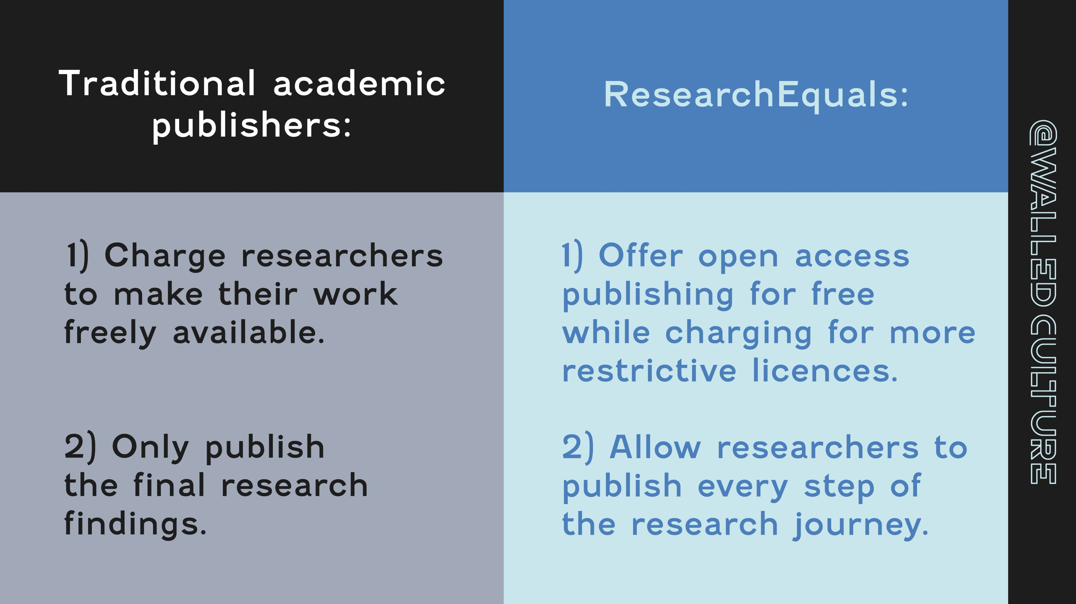

Slide 9
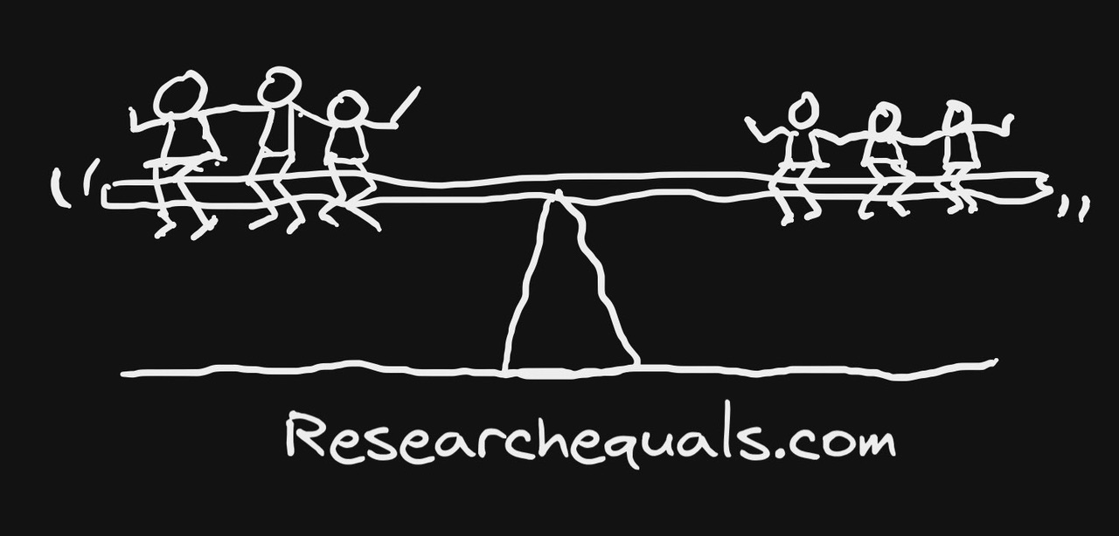
Sketch by @dasaptaerwin

Slide 10
Notes:
We’ll now head over to researchequals.com to demo the platform.
Please feel free to put your questions in the chat

Slide 11
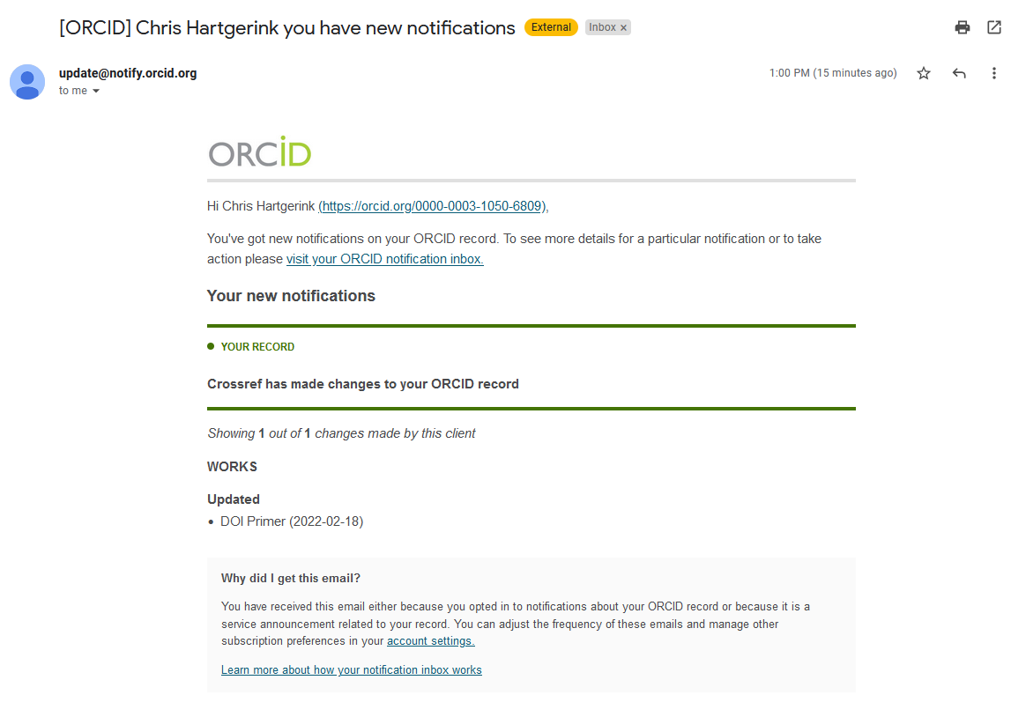

Slide 12
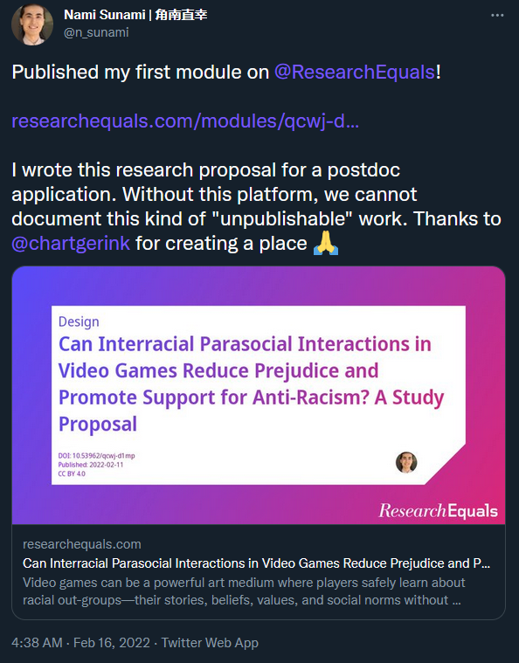

Slide 13
Summary
R= new open access publishing platform
Publish research steps
Publish your work, don’t work to publish
Scholar led platform
Come co-create:
Discord: https://discord.gg/SefsGJWWSw
GitHub: https://github.com/libscie/ResearchEquals.com

